Slide 1
Customer Churn Prediction
Machine Learning Project Presentation
Presented by Brenda Chepkemoi

Slide 2
Project Overview
SyriaTel yriaTel is experiencing customer churn, which leads to revenue loss. Retaining existing customers is often more cost-effective than acquiring new one
Predict customer churn and provide business insights to improve retention.

Slide 3

Models Used
Logistic Regression
Decision Tree
Random Forest
Gradient Boosting
Voting Ensemble

Slide 4
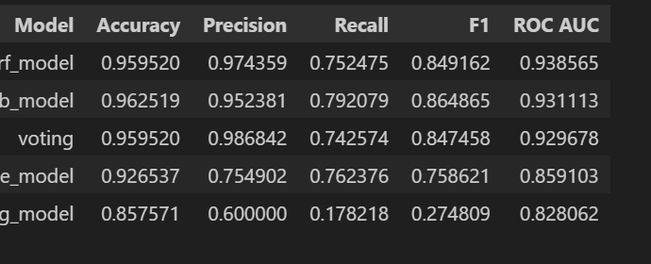
Best Model
Gradient Boosting:
Highest Accuracy, F1-score, and Recall

Slide 5
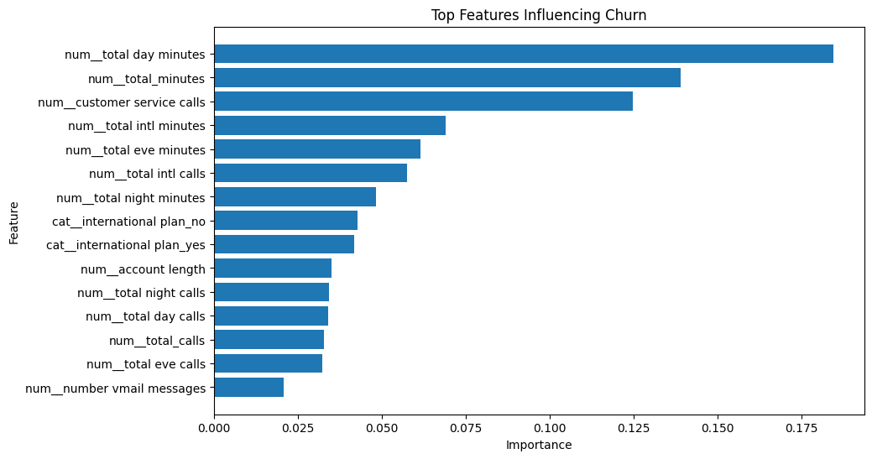
Feature Importance
High total usage (minutes) increases churn likelihood
Frequent customer service calls indicate dissatisfaction
Customer behavior patterns are strong predictors of churn

Slide 6
Recommendations
Improve customer service response for frequent callers
Offer personalized plans for high-usage customers
Use model predictions to identify high-risk customers early
Implement targeted retention strategies
I recommend deploying the Gradient Boosting Model as it has the high recall thus best protection on revenue loss.

Slide 7
Limitations
Limited dataset
No causation
Model drift possible
Low interpretability

Slide 8
Conclusion
Machine learning models can effectively predict customer churn and provide valuable insights.
Applying these insights can help businesses reduce churn and improve customer satisfaction.

